Slide 1
Planning and Organizing
Objective: To familiarize students with the planning and organizing and identify their emerging issues in ICT enterprises
6 hrs

Slide 2
2.1 Planning
A plan is defined as “ a document stating the goals, outlining the action oriented strategies to attain these goals, and assigning organizational resources to attain them.”
Characteristics of organizational planning:
Planning is goal oriented
Planning is future oriented
Planning deals with the uncertainty of upcoming future
Planning is a thinking process
Planning is action oriented

Slide 3
A Planning Model
Desired future state
Assessment of environmental opportunities and threats
Strategic Gap
Need for planning
Present State

Slide 4
Planning System
Input
Process
Output
Expected output after planning are intertwined and arranged as
Vision (Non specified directional and motivational guidance)
Mission (Purpose and philosophy that drives in long run)
Goals (Goals are there to achieve mission that provides direction to the activities)
Objectives (Specific statement to be done to achieve goals) SMART
Specific, Measurable, attainable, Rewarding and TImed
Plans (Action or means to achieve the intended goals)
Programmes, Budgets, and Priorities

Slide 5
2.1.1 Levels of planning: strategic, tactical and operational
Middle Level is
Tactical
Lower level is
Operational
Top down planning is centralized
Top Level is Strategic
Bottom up planning is decentralized
Composite planning is a combination of two
Team planning is a cross functional team of experienced managers

Slide 6
2.1.1 Levels of planning: strategic, tactical and operational
Tactical Planning
Operational Planning
Strategic Plans are grand plans based on SWOT
Strategic Planning
Tactical planning is done to convert the broad strategic goals and plans into specific goals
Operational planning is to identify the specific procedures and processes required at lower level

Slide 7
Managerial Hierarchy and the Planning System
Policies
Standing Plans
SIngle Use Plans
Programs
Procedures
Rules
Budgets

Slide 8
Steps in Planning
There are five steps in planning Process
Establish Goals
Identify Premises
Identify Alternatives
Test the practicality of Alternatives
Select and Announce the Final Plans

Slide 9
2.1.3 Tools for planning
Tools of Planning are based on concept of strategic planning
For developing strategic plan manager need to assess the organizational situation with the five basic questions:
Where are we now? (The situation)
How did we get there? (Momentum)
Where are we going? (The Direction)
Where should we be going? (Desired Direction)
How will we get there? (The Strategic Plan)

Slide 10
Tools to aid strategic planning
Forecasting
Qualitative
Informed Judgements
Scenario Analysis
Delphi Method
Quantitative
Single Projection method
Extrapolation method
Moving Average Method
Time Series Analysis

Slide 11
Tools to aid strategic planning
2. Network Techniques
CPM (Critical Path Method)
PERT (Program Evaluation and Review Technique)
3. Flow Charts
4. Gantt Chart
5. Break Even Analysis
BEP = FC/(P-VC)
Where, BEP = Break Even Point, FC = Fixed Cost, VC = Variable Cost, P = Price

Slide 12
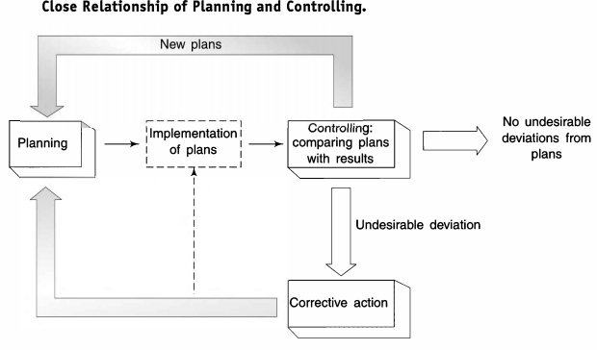
2.1.4 Importance of planning

Slide 13
2.1.4 Importance of planning
Goal Clarity – Defines clear objectives and direction for all departments and employees.
Efficient Resource Use – Ensures optimal allocation and utilization of time, money, and manpower.
Risk Reduction – Anticipates challenges and prepares strategies to minimize potential risks.
Improved Decision-Making – Provides a framework for making consistent, informed, and strategic choices.
Coordination & Control – Aligns activities across the organization and facilitates monitoring and corrective actions.

Slide 14
2.2 Organizing
The Logic of Organizing:
Establishing enterprise objectives
Formulating supporting objectives, policies, and plans
Identifying, analyzing, and classifying the activities necessary to accomplish these objectives
Grouping these activities in light of the human and material resources available and the best way, under the circumstances, of using them
Delegating to the head of each group the authority necessary to perform the activities
Tying the groups together horizontally and vertically, through authority relationships and information flows

Slide 15
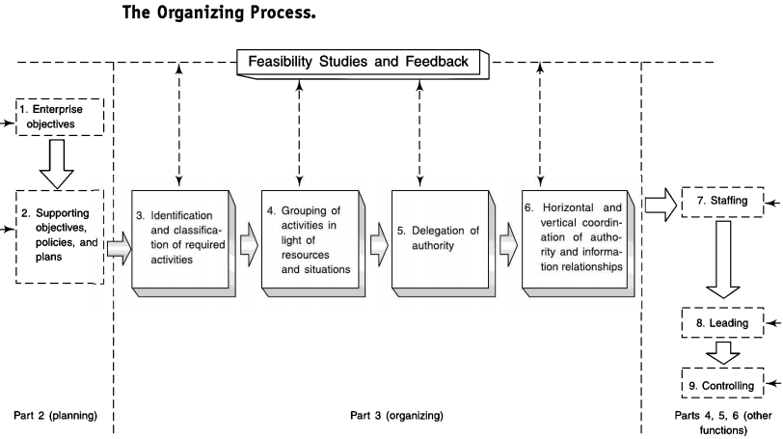

Slide 16
Some Misconceptions
Organizing does not imply any extreme occupational specialization
To say that tasks should be specific is not to say they must be limited and mechanical
In any organization, jobs can be defined to allow little or no personal leeway
One must not forget that there is no best way to organize and that the application of structural organization theory must take into account the situation

Slide 17
Basic Questions for Effective Organizing
What determines the span of management and hence the levels of organization? (answered in this chapter)
What determines the basic framework of departmentation, and what are the strengths and weaknesses of the basic forms? (answered in Chapter 8)
What kinds of authority relationships exist in organizations? (answered in Chapter 9)
How should authority be dispersed throughout the organization structure, and what determines the extent of this dispersion? (answered in Chapter 9)
How should the manager make organization theory work in practice? (answered in Chapter 10)

Slide 18
Six key elements in organizational design.
Work specialization
Departmentalization
Chain of command
Span of control
Centralization/decentralization
Formalization

Slide 19
2.2.2 Organization structure
Departmentalization
Grouping activities in accordance with the functions of an enterprise functional departmentation embodies what enterprises typically do
Because all enterprises undertake the creation of something useful and desired by others, the basic enterprise functions are:
production (creating utility or adding utility to a product or service)
selling (finding customers, patients, clients, students, or members who will agree to accept the product or service at a price or for a cost)
financing (raising and collecting, safeguarding, and expending the funds of the enterprise).

Slide 20
Departmentation
By Enterprise Function
By Territory or Geography
By Customer Group
By Product
By Process
Assignment: Draw the organization structure of various enterprises based on the types of departmentation types and write down their advantages and disadvantages

Slide 21
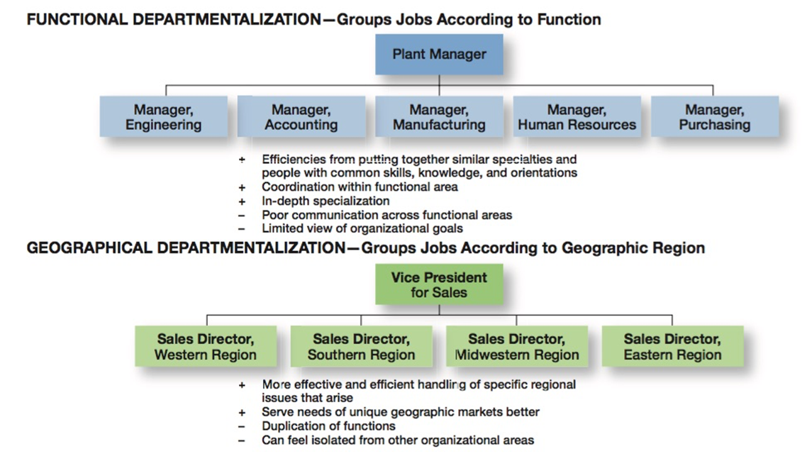

Slide 22
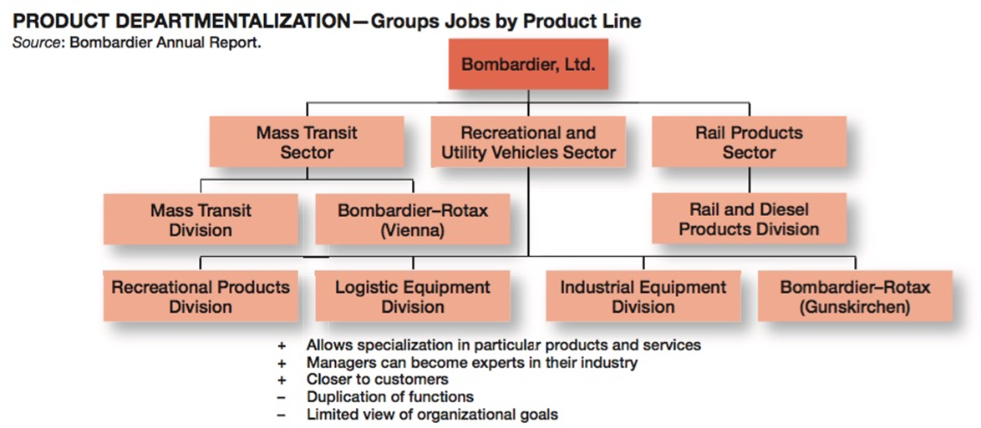

Slide 23
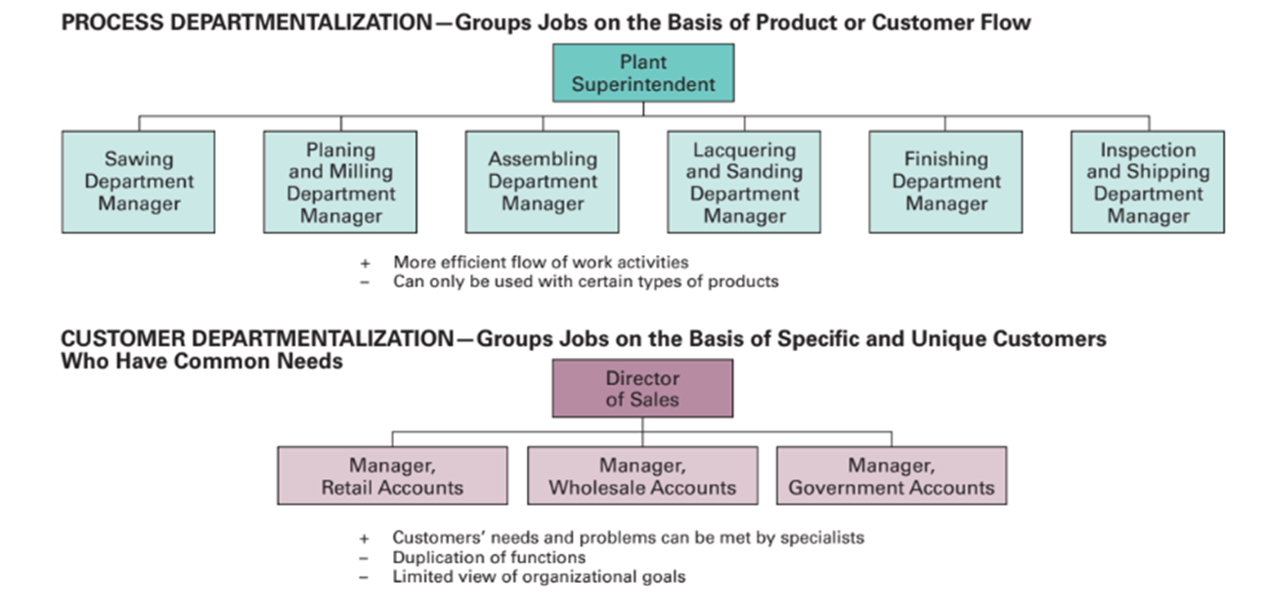

Slide 24
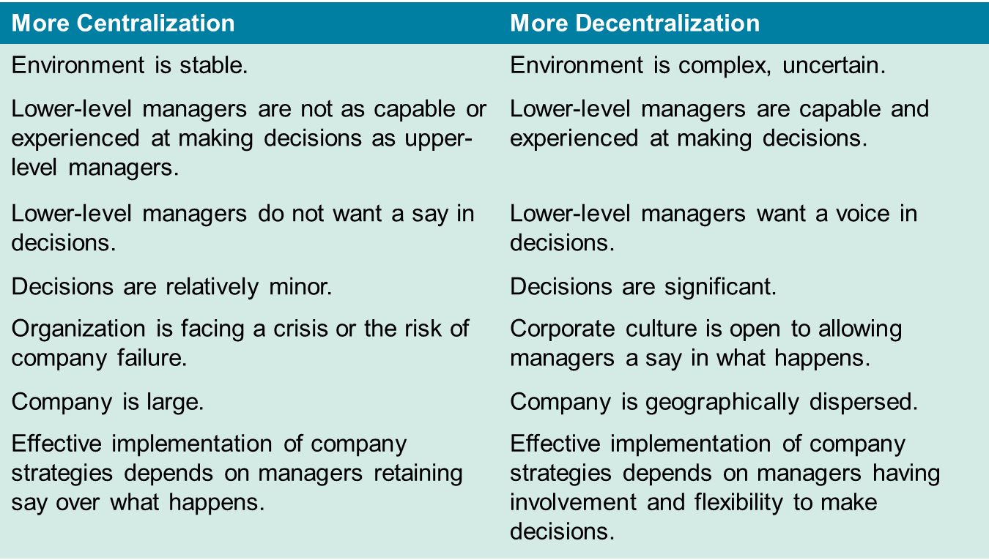

Slide 25
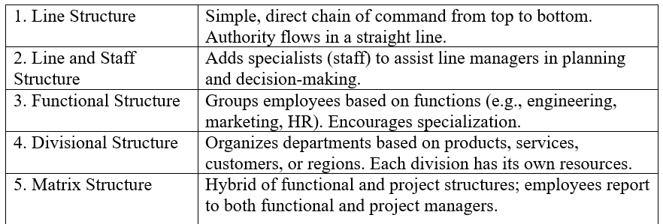
2.2.3 Types of organization structure

Slide 26
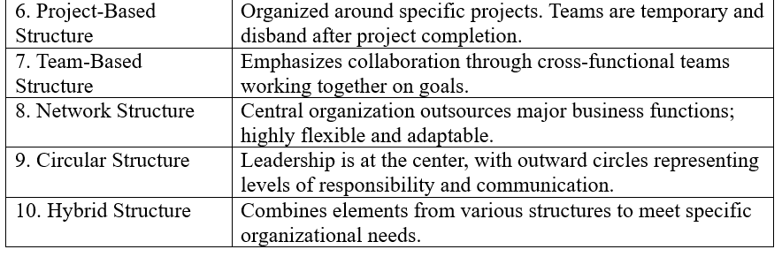
2.2.3 Types of organization structure

Slide 27
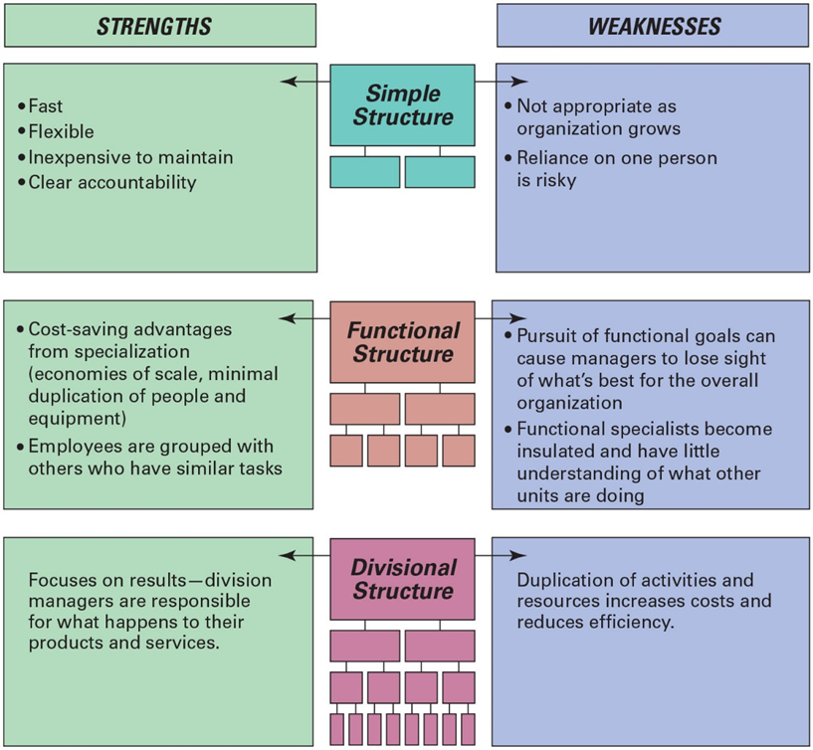

Slide 28
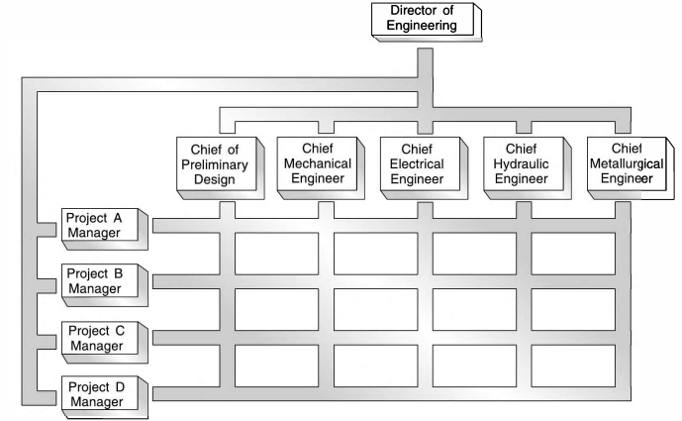
Matrix Organization in Engineering
Advantages:
Oriented toward end results
Professional identification is maintained
Pinpoints product-profit responsibility
Disadvantages:
Conflict in authority
Possibility of disunity
Requires manager effective in human relations

Slide 29
Guidelines for Making Matrix Management Effective
Matrix management can be made more effective by following these guidelines:
Define the objectives of the project or task
Clarify the roles, authority, and responsibilities of managers and team members
Ensure that influence is based on knowledge and information, rather than on rank
Balance the power of functional and project managers
Select an experienced manager for the project who can provide leadership
Undertake organization and team development
Install appropriate cost, time, and quality controls that report deviations from standards in a timely manner
Reward project managers and team members fairly

Slide 30
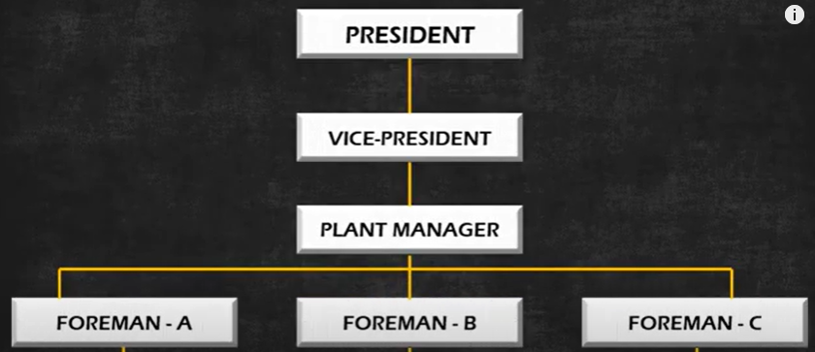
2.2.2.1 Traditional structure: line and functional
Advantages
Direct Supervision
Chain of Command
Oldest and Simplest
Unified Control
Fixed Responsibilities
Prompt Decision
Disadvantages
Inadequate simplex communication
Less effective coordination
Misuse of authority

Slide 31
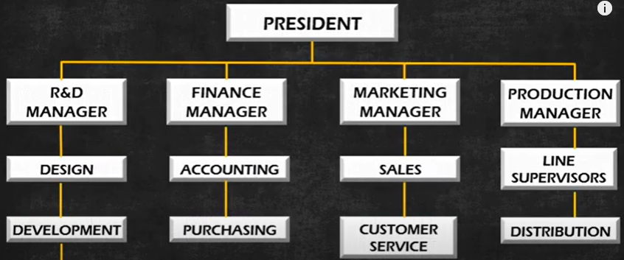
2.2.2.1 Traditional structure: line and functional
Advantages
Specialization
Operational Efficiency
Clear Hierarchy
Career Development
Economies of Scale
Focused supervision
Enhanced Performance
Disadvantages
Poor interdepartmental communication
Conflict of Interest
Slow Decision Making with limited flexibility

Slide 32
2.2.2.2 Modern structure: matrix, network, hybrid
Matrix: Project-heavy organizations (e.g., construction, aerospace, R&D) needing dual focus on function and projects
Network: Agile, tech-driven firms focusing on innovation, outsourcing, or partnerships (e.g., start-ups, software, consulting)
Hybrid: Large, diversified firms needing a balance between control and flexibility (e.g., multinational corporations)

Slide 33
2.4 Emerging planning and organizing issues for ICT enterprises
1. Rapid Technological Change
Need for continuous technology forecasting and agile strategic planning.
Constant updating of infrastructure and platforms (e.g., cloud, AI, blockchain).
2. Cybersecurity and Data Privacy
Strategic planning must account for robust cybersecurity frameworks.
Adherence to global data regulations like GDPR, HIPAA, etc.

Slide 34
2.4 Emerging planning and organizing issues for ICT enterprises
3. Talent Management & Skill Gaps
Shortage of skilled professionals in AI, data science, cybersecurity, etc.
Need for continuous learning systems and remote talent integration.
4. Agile and Lean Structures
Shift from traditional hierarchies to agile, flat, and cross-functional teams.
Emphasis on DevOps and Scrum practices for flexible organizing.

Slide 35
2.4 Emerging planning and organizing issues for ICT enterprises
5. Globalization & Virtual Workforces
Organizing across time zones, cultures, and legal systems.
Greater reliance on remote collaboration tools and distributed teams.
6. Sustainability and Green IT
Planning for eco-friendly data centers, energy-efficient devices, and e-waste management.
Growing pressure to meet ESG (Environmental, Social, Governance) targets.

Slide 36
2.4 Emerging planning and organizing issues for ICT enterprises
7. Innovation and Disruption Management
Strategic focus on R&D, innovation hubs, and partnership ecosystems.
Managing the threat of disruptive startups and platform-based competitors.
8. Regulatory Compliance & Ethics
Need to adapt to rapid changes in ICT-related regulations.
Ethical concerns around AI bias, surveillance, and automation must be planned for.

Slide 37
2.4 Emerging planning and organizing issues for ICT enterprises
9. Scalability and Cloud Infrastructure
Organizing around cloud-first strategies and hybrid cloud models. Planning for scalable digital infrastructure to support growth.
10. Customer-Centric Planning
Shift towards UX/UI design, customer analytics, and personalization. Integration of customer feedback loops into planning cycles.

